Slide 1
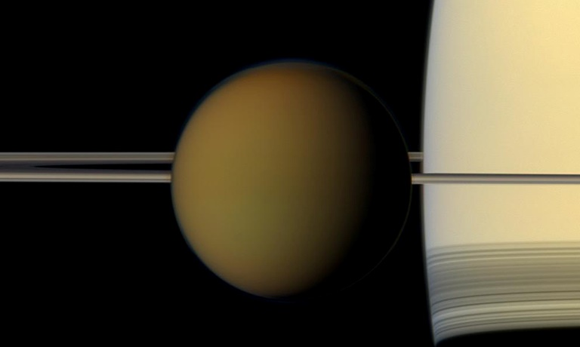
Astrobiological Potential on Titan?
Part 3
Review and Discussion of Astrobiology Publications
Membrane alternatives in worlds without oxygen: Creation of an azotosome
  Stevenson et al. Sci. Adv. 2015;1:e1400067 27 February 2015
ALMA detection and astrobiological potential of vinyl cyanide on Titan
  Palmer et al., Sci. Adv. 2017;3: e1700022 28 July 2017
Dave Jordan
November 14, 2017

Slide 2
Topics of Discussion
Part 1
Background
  Cassini-Huygens Mission to Saturn
Part 2
  Chemical/Biological Evolution
Part 3
Alternative Potential for Life
  Membrane alternatives in worlds without oxygen: Creation of an azotosome
ALMA Data for Titan
  ALMA detection and astrobiological potential of vinyl cyanide on Titan
What’s Next
Discussion

Slide 3
Another Potential for Life
A New Hypothesis for the Development of Life
Membrane alternatives in worlds without oxygen: Creation of an azotosome
Stevenson et al. Sci. Adv. 2015;1:e1400067 27 February 2015

Slide 4
Membrane Alternatives
Life as we know it!
The lipid bilayer membrane (vesicle) is not viable outside of biology based on liquid water.
Astronomers search for exoplanets within the “habitable zone” where liquid water can exist
Life as we never imagined?
Can cell membranes be created and function at temperatures far below where water is a liquid?
    Develop hypothesis for new type of membrane composed of small organic nitrogen compounds
    Capable of forming and functioning in liquid methane at cryogenic temperatures
    Demonstrate via molecular simulations these membranes in a cryogenic solvent (Methane)
    Show they have an elasticity and stability equal to that of lipid bilayers membranes in liquid water
    Cryogenic membranes could arise from compounds observed in the atmosphere and seas of Titan

Slide 5
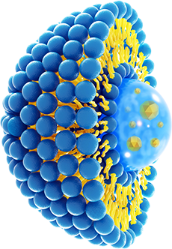
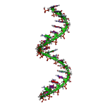
“Lipid World” Hypothesis
Liposomes (Vesicles of Lipids)
Terrestrial cell membranes are composed of a bilayer of nonpolar lipid chains and oxygen laden polar heads.
The polar heads form surfaces allowing the membrane to separate the aqueous world outside and the aqueous life within.
The lipid tails of the phospholipids aggregate by van der Waals forces, thus stabilizing the membrane.
Creation of RNA
Research has shown that RNA catalysis depends on high local concentrations (compartmentalization)
Lipid membranes played an important role as a very early evolutionary step in creating life on Earth.
Lipid bilayers have been observed to grow, divide, aid polymerization reactions, and even synthesize RNA

Slide 6
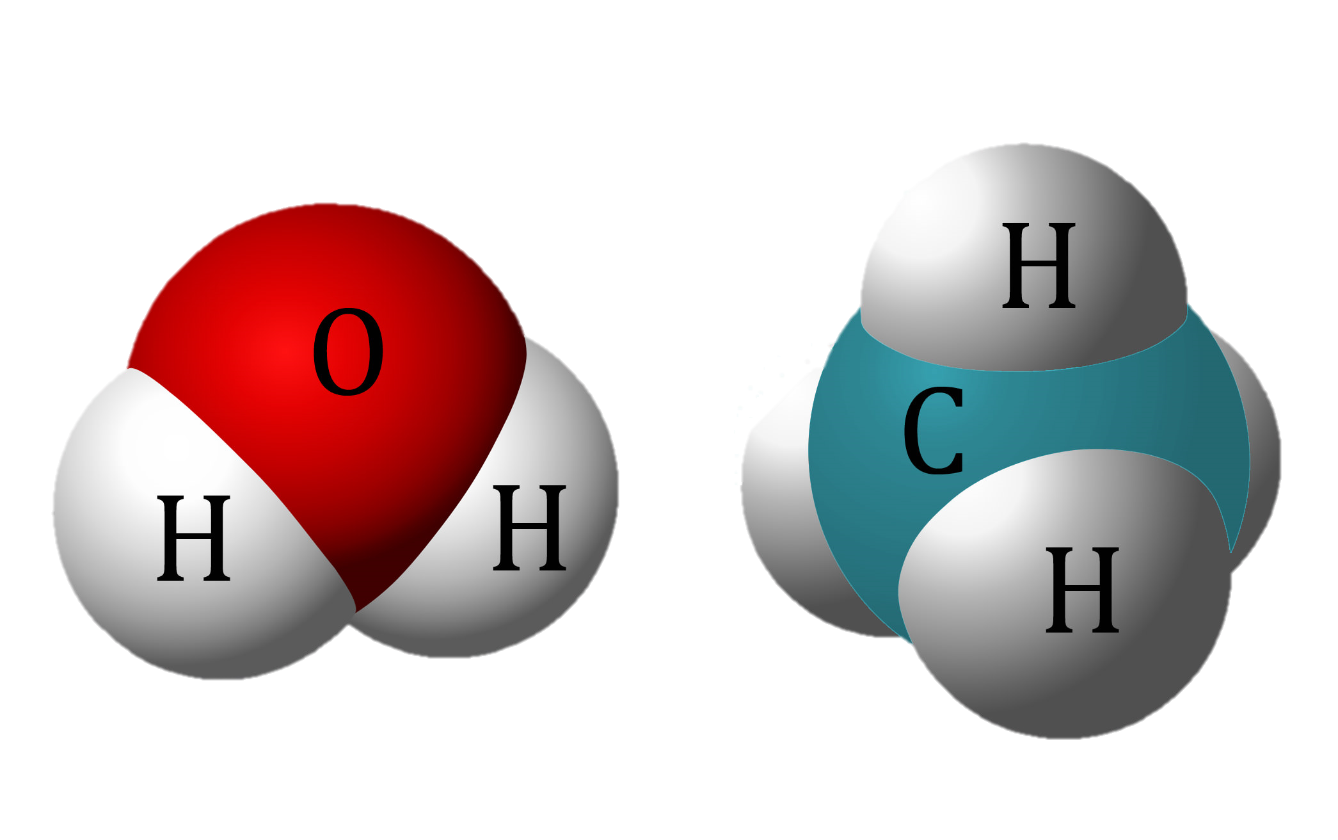
Vesicles on Titan?
Water
Methane
Can Vesicles form in Liquid Methane on Titan?
Experiments have created vesicles in non-polar solvents such as nonionic ethers, etc.
Liquid methane is of interest because it is the only liquid other than water that forms seas on the surface of planetary bodies such as Saturn’s moon, Titan
Titan’s surface hosts an unknown process that consumes hydrogen, acetylene, and ethane, all of which continually flow down from the atmosphere but do not accumulate
Makes liquid methane a very interesting solvent to consider for cell membrane alternatives.
Liposomes are not Possible
Inverse phospholipid membranes been considered as biological possibilities in liquid methane
However, phospholipid membranes do not perform as well in liquid methane.
Phospholipid head component atoms, oxygen, etc., are not available in the methane seas of Titan
Inverted-phase liposomes are therefore not a viable option using polarity to prevent dissolution
Polar
Non-Polar

Slide 7
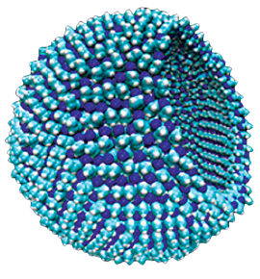
Azotosome Hypothesis
Liquid Methane Vesicles
Hypothesis: Liquid methane membranes would rely on the polarity of nitrogen-containing groups (“azoto” groups) to hold them together
  Similar to how terrestrial liposomes rely on the non- polarity of alkyl groups.
The key physical requirements of a membrane are that it be flexible (expansion modulus).
  Several azotosome candidates within accepted range
Measure of stability is the decomposition energy or stability time scale
  Azotosome candidates have high decomposition energies relative to the cryogenic environment, resulting in very long stability time scales.

Slide 8
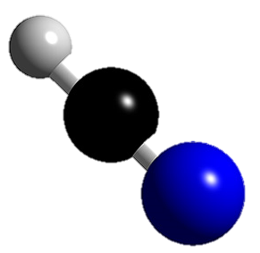
Azotosome Candidates
Hydrogen Cyanide
H
C
Cassini Observations
Spectroscopic observations by the Cassini orbiter show the most common polar nitrogen compounds in the upper portion of Titan’s methane-nitrogen atmosphere
N
Added primary nitriles and amines in study since laboratory experiments have produced similar compounds.

Slide 9
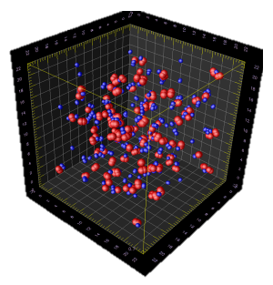
Experimental Methods
Molecular Dynamics Simulation
Synthesizing azotosomes in lab challenging due to cryogenic conditions
Azotosomes are similar to molecules routinely studied through standard molecular simulation
Molecular dynamics (MD) has been used to simulate bilayer membranes and polymer vesicles
Values of the expansion modulus calculated by MD agree closely with experiments
OPLS Models (Optimized Potentials for Liquid Simulations)
Optimized Potentials for Liquid Simulations (OPLS) used for molecular force models
Proven effective models for liquid hydrocarbons, small organic molecules, and polymersomes
Validated OPLS models for candidate molecules by confirming the OPLS-generated structures and pairwise binding energies against quantum mechanical calculations
Only molecules OPLS modeled consistently in terms of bond lengths, angles, and binding energies were passed on for study as azotosome candidates

Slide 10
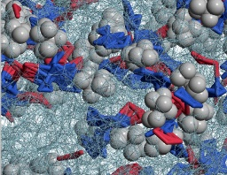
Azotosome Candidate Selection
OPLS Structure Errors
Three compounds exhibited errors for average bond lengths of greater than 0.04 Å and removed
  Cyanoacetylene, Cyanoallene, & 2,4-Pentadiynenitrile
  Being highly unsaturated, least likely to be stable when they leave the upper atmosphere
The Average Difference between the OPLS and initial structures for the remaining compounds were acceptable
  Average ΔBond Lengths = 0.008 Å
  Average ΔBond Angles = 0.6°
  Average ΔDihedrals = 0.3°

Slide 11

Azotosome Candidate Selection
OPLS Binding Energy Validation
Binding energies expected to fall between those in vacuum and in solvent because OPLS calculations are “solvent-like” due to the non polarizability of the OPLS model
HCN was removed since it had an OPLS binding energy 1.8 kcal/mol above the value predicted suggesting that the OPLS model of HCN is inaccurate
Ab initio DFT (Density Functional Theory) used to calculate binding energies from first principles of QM

Slide 12
Azotosome Candidate Selection
Nitrogen head positions in selected azotosomes
MD/OPLS Simulation
Azotosome begins the simulation as a grid of molecules, and then self-assembles into its preferred structure
  Initial grid
  Aminopentane (amorphous)
  Pentanenitrile (hexagonal)
  Acrylonitrile (close packed hexagonal)
Species that OPLS could not represent accurately were removed from consideration
  HCN did not form an ordered layer
  Hexane formed a solid

Slide 13
Azotosome Candidate Selection
Flexibility & Activation Energy
Plain hexane bilayer with no functional head added for comparison
Expect values of K_{a} & ΔE to be accurate within 20%
Remaining azotosomes candidates have flexibilities similar to those of known terrestrial cell membranes:
  0.13 to 0.55 J/m² for the azotosomes
  0.24 to 0.50 J/m² for terrestrial liposomes.
Azotosomes will appear stiffer than Earth liposomes because the thermal fluctuations on Titan are smaller than those on Earth
However, cryogenic azotosomes and room temperature liposomes will respond surprisingly alike with respect to mechanical stress
Area Expansion Modulus & Activation Energy of the remaining Azotosomes Candidates

Slide 14
Azotosome Candidate Selection
Stability of Azotosomes
All free energies are positive
  Azotosome state is preferable to the dissolved state
Free energy values are concentration dependent
  ΔG dissolve is always negative at infinite dilution
The real concentrations in Titan’s seas are currently unknown
  May or may not be high enough to make azotosomes thermodynamically stable

Slide 15
Simulation Results
Potential of Acrylonitrile
Geometry of the acrylonitrile molecule favor the azotosome and hamper other states
Acrylonitrile is known experimentally to have a somewhat disordered solid phase and can form a variety of structures
Acrylonitrile azotosomes are symmetrical with respect to the plane of the membrane
Like a lipid bilayer—they should be able to form vesicles of many sizes

Slide 16
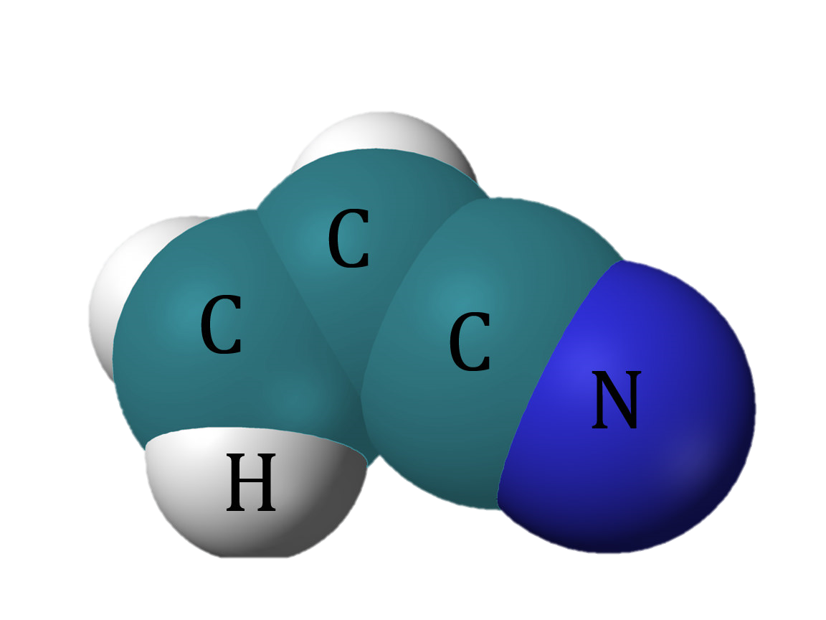
Discussion of Results
Acrylonitrile
Summary of Research Results
Vesicles needed for compartmentalization on Titan would be very different to those found on Earth
Azotosomes that form in liquid methane at cryogenic temperatures do so from the attraction between polar heads of short-chain molecules that are rich in nitrogen
Flexibility of such membranes is roughly the same as those of membranes formed in aqueous solutions
Despite cryogenic conditions they exhibit surprisingly similar responses to mechanical stress
On the basis of thermodynamic stability the azotosome appears to be a realizable cryogenic membrane
An Acrylonitrile azotosome has good thermodynamic stability, high energy barrier to decomposition, and area expansion modulus similar to that of phospholipid cell membranes in oxygen-rich solutions
Acrylonitrile exists in Titan’s atmosphere at a concentration of 10 ppm and could plausibly be formed on any celestial body with a nitrogen-methane atmosphere.
As our understanding of conditions that could nurture extraterrestrial life expands, so does our probability of finding it, perhaps within the liquid methane habitable zone.
a.k.a. Vinyl Cyanide

Slide 17
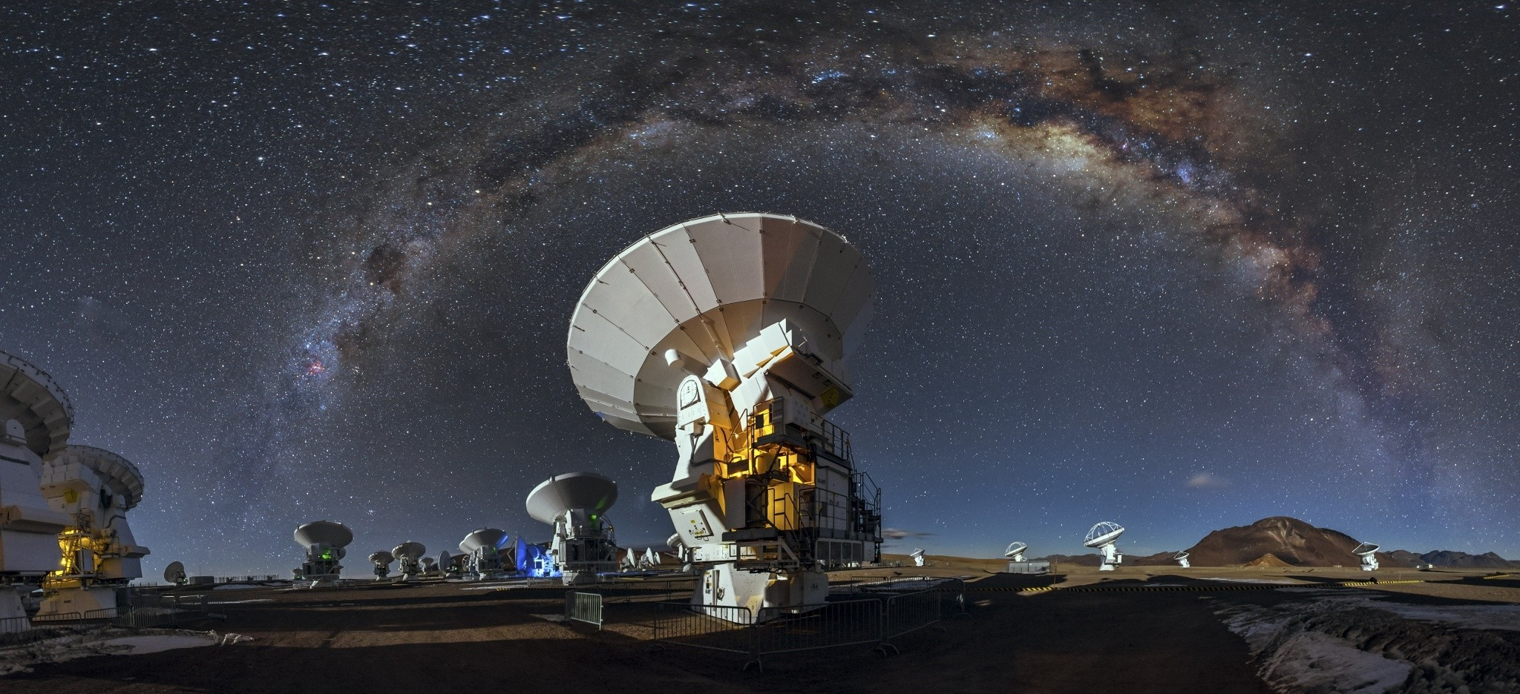
ALMA Data for Titan
ALMA detection and astrobiological potential of vinyl cyanide on Titan
Palmer et al., Sci. Adv. 2017;3: e1700022 28 July 2017
Atacama Large Millimeter/submillimeter Array

Slide 18

What is ALMA?
Atacama Large Millimeter/submillimeter Array
Currently the largest radio telescope in the world.
Cooperation between Europe (ESO), North America (NRAO) and East Asia (NAOJ), in collaboration with the Republic of Chile
The light in these millimetric and submillimetric wavelengths comes from vast cold clouds in space, at temperatures of just a few dozen degrees above absolute zero (-273oC), and from some of the earliest and furthest galaxies in our Universe.
This radio telescope is composed of 66 high-precision antennas, which operate on wavelengths of 0.32 to 3.6 mm.
Its main array has fifty antennas, each with 12-meter diameters, which act together as a single telescope: an interferometer.
This is complemented by a compact array of four antennas with 12-meter diameters and 12 antennas with 7-meter diameters. ALMA’s antennas can be configured in different ways, spacing them at distances from 150 meters to 16 kilometers, giving ALMA a powerful “zoom” variable, which results in images clearer than the images from the Hubble Space Telescope.
ALMA is already “irrigating” the fields of astronomy in depth, 24 hours a day, 365 days a year. Scientists foresee record harvests, where invisible light (radio waves) accumulated by ALMA will be vital to our understanding of the Universe.
The purpose of ALMA is to study star formation, molecular clouds and the early Universe, closing in on its main objective: discovering our cosmic origins

Slide 19
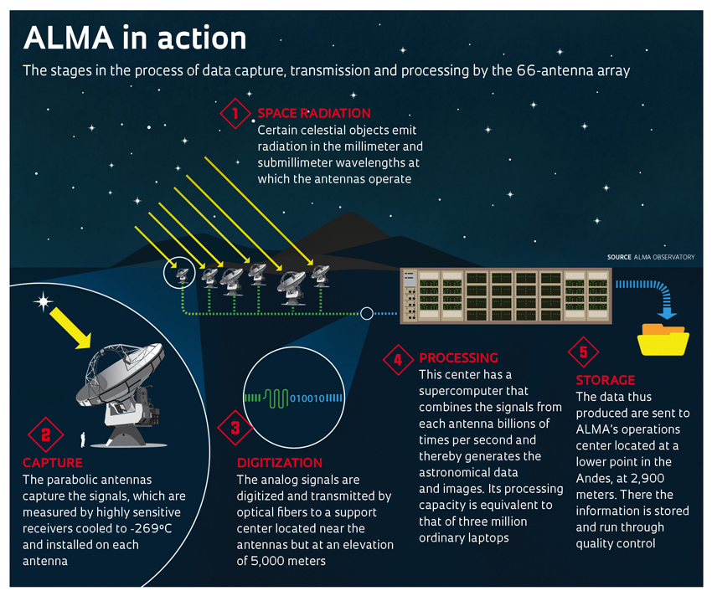
ALMA Data Collection
Data Collection & Storage
Celestial bodies emit radiation
Parabolic Antennas capture signal which are measured by receivers cooled to -269 C
The signal is digitized to eliminate loss during transmission
Data is processed to simulate a 16Km interferometer lens
Data is final stored for further scientific analysis

Slide 20
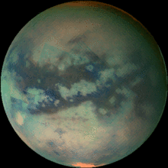

ALMA Data for Titan
Confirming Vinyl Cyanide on Titan
Vinyl cyanide is the best candidate for the formation of cell membranes/vesicle structures on Titan
Existence of vinyl cyanide (C₂H₃CN) on Titan was previously inferred using Cassini mass spectrometry
  A more definitive detection has been lacking until now
  Abundance data also needed to determine saturation levels
This is the first Rotational Spectroscopic detection of vinyl cyanide in Titan’s atmosphere
  Using archival data from the Atacama Large Millimeter/submillimeter Array (ALMA)
  Collected from February to May 2014
Rotational Spectroscopy is the measurement of the energies of transitions between quantized rotational states of molecules in the gas phase

Slide 21
ALMA Data for Titan
Rotational Line Frequencies
Research focused on confirming known rotational line frequencies and transitions for C₂H₃CN
Detected the three strongest rotational lines of C₂H₃CN in the frequency range of 230 to 232 GHz, each with >4σ confidence
  230,488 MHz
  230,739 MHz
  231,952 MHz

Slide 22
ALMA Data for Titan
Spectra of Vinyl Cyanide
(A) Observed ALMA spectrum of Titan in the vicinity of the CO
(B and C) Zoomed regions of two C₂H₃CN transitions detected in (A)
(D) Spectral region surrounding the third detected C₂H₃CN transition
All 3 C₂H₃CN lines were detected at precisely the correct frequency
  Greater than 4σ confidence
The detection of all expected lines of C₂H₃CN in this wavelength region confirms spectroscopic assignments

Slide 23
ALMA Data for Titan
Abundance Profiles by Altitude
The best fit is for z_{r} = 300 km
A poor fit is obtained for z_{r} < 200 km
Implies that most of the observed C₂H₃CN is at stratospheric/mesospheric altitudes of >200 km
Lack of detectable pressure broadening in observed C₂H₃CN line profiles leads to rejecting the lowest-altitude (z_{r} = 100 km) model

Slide 24
Discussion of Results
Astrobiological Importance of Findings
Confirmation of vinyl cyanide on Titan leads to the possibility of cell membrane–like azotosomes
  Cell membranes are a crucial component of any living organism
  Simulations indicate at the temperature of Titan’s methane lakes, vinyl cyanide could form stable membranes
A rain of haze particles continually carries organics, which form in the upper atmosphere, down to the surface, where they can participate in prebiotic or biotic reactions
Reactions of hydrocarbons with hydrogen, both readily available on Titan, release energy, which could provide support for methanogenic life
Calculated C₂H₃CN abundance implies that vinyl cyanide would reach saturation in Titan’s seas with the excess forming a solid precipitate
  An azotosome size of 10 mm corresponds to the possibility of 3 × 10⁷ azotosomes/cm³ in Titan’s Ligeia Mare sea
  For comparison, coastal ocean waters on Earth have ~10⁶ bacteria/cm³

Slide 25
What’s Next?
Further Investigations

Slide 26
Titan’s Astrobiological Potential
Areas for Further Investigation
New laboratory studies of gas-phase reactions that form C2H3CN are needed to better understand the origin of this molecule on Titan and in other extraterrestrial environments.
Experimental studies of membrane formation in cryogenic methane would help assess the viability of azotosome formation.
Infrared observations of Titan’s aerosol particles could identify the presence of condensed vinyl cyanide and provide insight into its transport to the surface
Additional ALMA observations with improved signal-to-noise ratio will permit the first detailed maps of the spatial distribution of C2H3CN, including abundance measurements over the northern seas and lakes
This could provide new insights into the possibility of incorporation of atmospheric photochemical products into potentially prebiotic structures in Titan’s hydrocarbon seas.

Slide 27
Search for Extraterrestrial Life
Titan and Other Liquid Methane Rich Bodies
What is the energy source for life to start?
Can we detect a chemical imbalance indicative of life?
Could we ever confirm azotosomes in the lab @ -200 C?
Enceladus
How can we gather more evidence for life?
Europa Clipper (Planned for 2020’s)
Europa Clipper mission will conduct detailed reconnaissance of Jupiter's moon Europa to see whether the icy moon could harbor conditions suitable for life.
The mission will carry a highly capable, radiation-tolerant spacecraft that will perform repeated close flybys of the icy moon from a long, looping orbit around Jupiter.

Slide 28
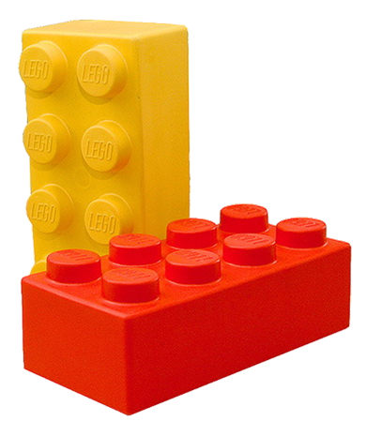
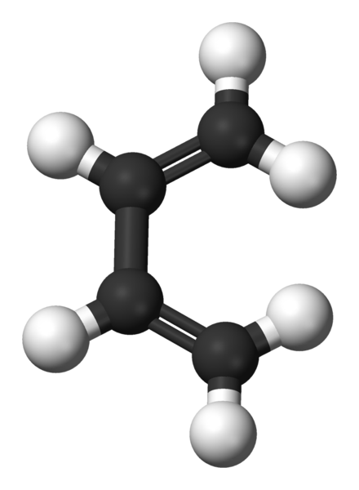
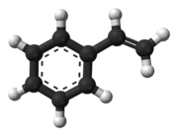
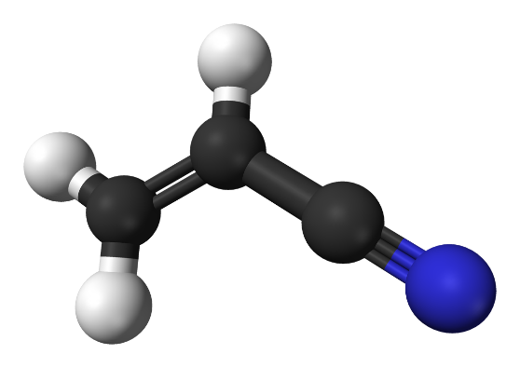
Building Blocks of Life
Could Vinyl Cyanide be another Building Block of Life?
Acrylonitrile
(a.k.a. Vinyl Cyanide)
Butadiene
Styrene
+
+
=
Afterall, it is the main ingredient for Lego building blocks!

Slide 29
Thank You

